Slide 1


CE141: COMPUTER CONCEPTS & PROGRAMMING
July – November 2018
Chapter – 13
Structures
Devang Patel Institute of Advance Technology and Research

Slide 2


Objectives
To explain the basic concepts of structure
To process a structure
To manipulate data using a struct
To Learn about the relationship between a struct and functions
To discover how arrays are used in a struct
To create an array of struct items
To explain the concept of unions
Chapter – 13 : Structures

Slide 3
Introduction
In this chapter, we will discuss
Need of user-defined data type
Structure definition
Declaration and Initialization of variables
Array as member
Array of structure variables
Structure within structure
Structure as function arguments
Union
Bit fields
Chapter – 13 : Structures
Chapter – 9 : Looping

Slide 4
Need of user-defined data type
    To support database, file read/write, and print operations.
    A user-defined data type lets you group data of different types in a single variable.
    This data type can contain any kind of related information you want to store and use together, such as personnel information, company financial information, inventory, and customer and sales records.
    A variable of a user-defined data type holds actual data, not a pointer to that data.
Chapter – 13 : Structures
Chapter – 9 : Looping

Slide 5
Structure definition
A structure can be considered as a template used for defining a collection of variables under a single name.
Structures help programmers to group elements of different data types into a single logical unit (Unlike arrays which permit a programmer to group only elements of same data type).
Structures are commonly used to define records to be stored in files Structures are very powerful concept that programmers use in many C programs.
Chapter – 13 : Structures
Chapter – 9 : Looping

Slide 6
Structure definition Continue…
Syntax
struct tag {
  member 1;
  member 2;
        :
  member m;
  };
struct is the required C keyword
tag is the name of the structure
member 1, member 2, … are individual member declarations
Chapter – 13 : Structures
Chapter – 9 : Looping

Slide 7
Structure definition Continue…
The individual members can be ordinary variables, pointers, arrays, or other structures (any data type)
The member names within a particular structure must be distinct from one another
A member name can be the same as the name of a variable defined outside of the structure
Once a structure has been defined, the individual structure-type variables can be declared as:
struct tag var_1, var_2, …, var_n;
Chapter – 13 : Structures
Chapter – 9 : Looping

Slide 8
Structure definition Continue…
A Compact Form Syntax :
It is possible to combine the declaration of the structure with that of the structure variables:
struct tag {
member 1;
member 2;
:
member m;
} var_1, var_2,…, var_n;
Declares three variables of type struct tag
In this form, tag is optional
Chapter – 13 : Structures
Chapter – 9 : Looping

Slide 9
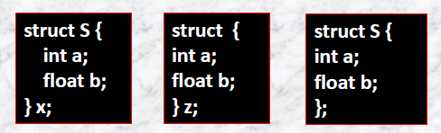
Structure definition Continue…
Various Structure declaration form :
Declares x to be a structure
having two
members, a and b. In addition,
the structure tag S is created for
use in future declarations
Omitting the tag
field;
cannot create any more variables with the same type as z
Omitting the variable list defines the tag S for use in later declarations
Chapter – 13 : Structures
Chapter – 9 : Looping

Slide 10


Structure definition Continue…
Omitting the member list declares another structure variable y with the same type as x omitting.
Incomplete declaration which informs the compiler that S is a structure tag to be defined later .
Chapter – 13 : Structures
Chapter – 9 : Looping

Slide 11
Structure definition Continue…
Example 1:
In Cartesian coordinates any point can be described with two numbers corresponding x- and y-coordinates.
struct point {
int x;
int y;
};
Name Tag – kind of structure
Members of Structure
Members are defined within braces as regular variable definitions
struct statement ends with “ ; ” as other statements in C
Chapter – 13 : Structures
Chapter – 9 : Looping

Slide 12
Structure definition Continue…
Note
This is just the structure definition. Structure definitions doesn’t consume any space on the memory.
Chapter – 13 : Structures
Chapter – 6 : Operators and Expression in ‘C’
Chapter – 9 : Looping

Slide 13
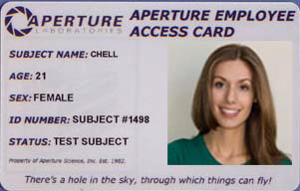
Structure definition Continue…
Example 2:
Let’s suppose that we are dealing with the employee records; employee’s record contains information such as employee’s first and last names, employee’s age, 'M' or 'F' for the employee’s gender and the employee’s hourly salary.
Employee Information:
First Name : Character array
Last Name : Character array
Age : Integer
Gender : A character
Hourly Salary : Double
Chapter – 13 : Structures
Chapter – 9 : Looping

Slide 14
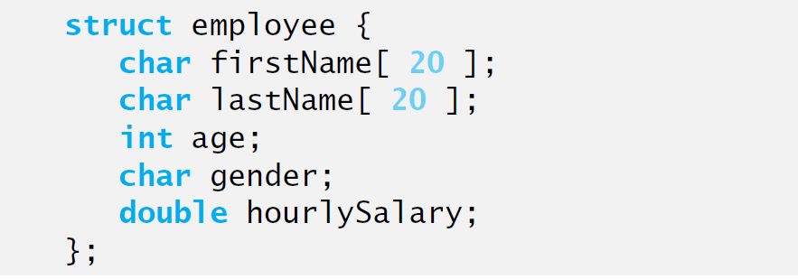
Structure definition Continue…
Example 2 Continued…
We can define a structure type with tag, employee
Chapter – 13 : Structures
Chapter – 9 : Looping

Slide 15
Structure definition Continue…
Note
Members of a structure can be primitive data types and as well
as another structure.
Chapter – 13 : Structures
Chapter – 6 : Operators and Expression in ‘C’
Chapter – 9 : Looping

Slide 16
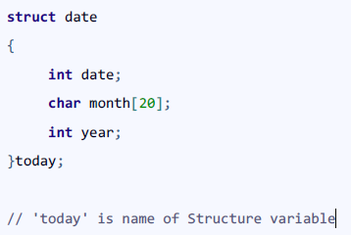
Declaration and Initialization of variables
Different Ways of Declaring Structure Variable :
Way 1 : Immediately after Structure Template
Chapter – 13 : Structures
Chapter – 9 : Looping

Slide 17
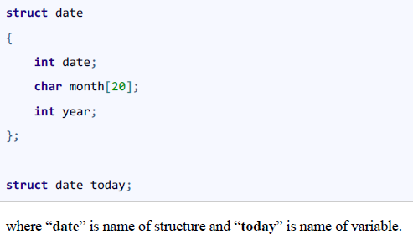
Declaration of variables Continue…
Way 2 : Declare Variables using struct Keyword
Chapter – 13 : Structures
Chapter – 9 : Looping

Slide 18
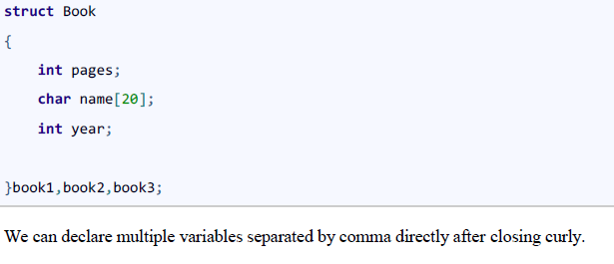
Declaration of variables Continue…
Way 3 : Declaring Multiple Structure Variables
Chapter – 13 : Structures
Chapter – 9 : Looping

Slide 19


Initialization of variables
Different ways to initialize structure variable :
Way 1 : Declare and Initialize
In the code snippet, we have seen that structure is declared and as soon as after declaration we have initialized the structure variable.
std1 = { "Pritesh",67,78.3 }
Chapter – 13 : Structures
Chapter – 9 : Looping

Slide 20
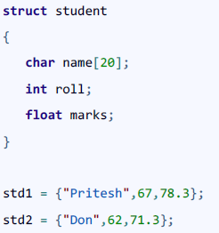
Initialization of variables Continue…
Way 2 : Declaring and Initializing Multiple Variables
In this example, we have declared two structure variables in above code. After declaration of variable we have initialized two variable.
std1 = {"Pritesh",67,78.3};
std2 = {"Don",62,71.3};
Chapter – 13 : Structures
Chapter – 9 : Looping

Slide 21
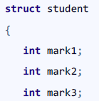
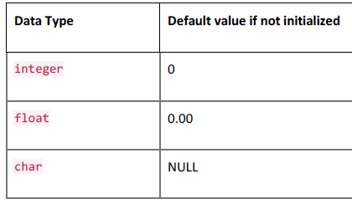

Initialization of variables Continue…
Way 3 : Initializing Single member
Though there are three members of structure, only one is initialized , Then remaining two members are initialized with Zero. If there are variables of other data type then their initial values will be -
Chapter – 13 : Structures
Chapter – 9 : Looping

Slide 22
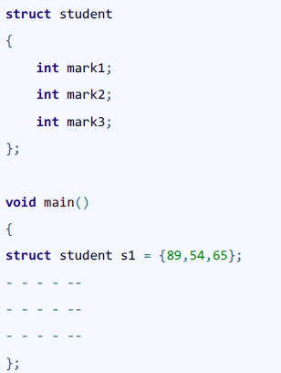
Initialization of variables Continue…
Way 4 : Initializing inside main
We need to initialize structure variable to allocate some memory to the structure.
Chapter – 13 : Structures
Chapter – 9 : Looping

Slide 23
Declaration and Initialization of variables Continue…
Note
When we declare a structure then memory won’t be allocated for the structure, only writing declaration statement will never allocate memory
Chapter – 13 : Structures
Chapter – 6 : Operators and Expression in ‘C’
Chapter – 9 : Looping

Slide 24
Accessing Structure variable
So far, we have learned how to define a structure, but didn’t talk about how to use it.
In order to use structures, we should be able to access the members of the structure.
Two operators are used to access members of structures:
1. The structure member operator ( . ) – also called dot operator.
VariableName.MemberName
2. The structure pointer operator (->) – also called arrow operator.
PointerName->MemberName
It is possible define a pointer to a structure. -> is used to access the member of the structure variable via pointers.
Chapter – 13 : Structures
Chapter – 6 : Operators and Expression in ‘C’
Chapter – 9 : Looping

Slide 25
Accessing Structure variable
Example : Accessing Structure variable using dot (.) Operator
Let’s now consider the date structure (mm/dd/yyyy)
struct date{ /*Defining Structure Type*/
int month;
int day;
int year;
};
struct date today;
Members of the today structure variables can be accessed via . operator.
We can print, read, or assign any value to members by accessing
them using . operator.
Chapter – 13 : Structures
Chapter – 6 : Operators and Expression in ‘C’
Chapter – 9 : Looping

Slide 26
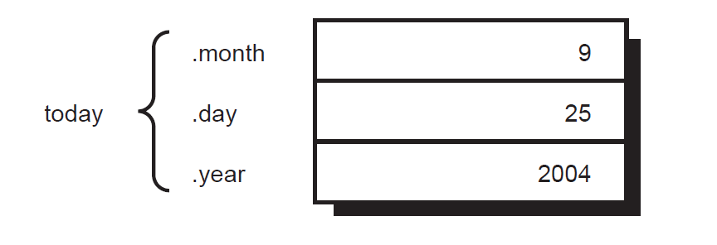
Accessing Structure variable
Example Continue…
today.month = 9;
today.day = 25;
today.year = 2004;
Below printf statement prints the date in (mm/dd/yyyy) format.
printf(“%d/%d/%d”, today.month, today.day, today.year);
Chapter – 13 : Structures
Chapter – 6 : Operators and Expression in ‘C’
Chapter – 9 : Looping

Slide 27
Declaration and Initialization of variables Continue…
Some Important Points Regarding Structure in C Programming :
1. Struct keyword is used to declare structure.
2. Members of structure are enclosed within opening and closing braces.
3. Declaration of Structure reserves no space.
4. It is nothing but the “ Template / Map / Shape ” of the structure .
5. Memory is created , very first time when the variable is created /Instance is created.
Chapter – 13 : Structures
Chapter – 6 : Operators and Expression in ‘C’
Chapter – 9 : Looping

Slide 28
Array as member
We can use structure and array as :
1. Array within Structure (Array as Member)
2. Array of Structure
1. Array as Member :
Structure may contain the Array as its Member.
We can store name,roll,percent as structure members , but sometimes we need to store the marks of three subjects then we embed integer array of marks as structure member.
Syntax :
struct struct-name
{
datatype var1; // normal variable
datatype array [size]; // array variable
datatype varN;
};
struct struct-name obj;
Chapter – 13 : Structures
Chapter – 9 : Looping

Slide 29
Array as member
Example 1 :
struct student
{
char sname[20]; // array variable
int roll;
float percent;
int marks[3]; // array variable
}s1;
Chapter – 13 : Structures
Chapter – 9 : Looping

Slide 30
Array as member Continue…
Example Continue…
#include <stdio.h>
struct student
{
char sname[20];
int marks[3]; //Note Carefully
}s1;
int main()
{
printf("\nEnter the Name of Student : ");
gets(s1.sname)
Chapter – 13 : Structures
Chapter – 9 : Looping

Slide 31
Array as member Continue…
Example Continue…
printf("\nEnter the Marks in Subject 1 :"); scanf("%d",&s1.marks[0]);
printf("\nEnter the Marks in Subject 2 : ");
scanf("%d",&s1.marks[1]);
printf("\nEnter the Marks in Subject 3 : "); scanf("%d",&s1.marks[2]);
printf("\n ---- Student Details -------- ");
printf("\n Name of Student : %s",s1.sname);
printf("\n Marks in Subject 1 : %d",s1.marks[0]);
printf("\n Marks in Subject 2 : %d",s1.marks[1]);
printf("\n Marks in Subject 3 : %d",s1.marks[2]);
return 0; }
Chapter – 13 : Structures
Chapter – 9 : Looping

Slide 32
Array as member Continue…
Example 2: Create another structure called student to store name, roll no and marks of 5 subjects.
struct student
{
char name[20]; // array variable
int roll_no;
float marks[5]; // array variable
};
If student_1 is a variable of type struct student then
student_1.marks[0] - refers to the marks in the first subject
student_1.marks[1] - refers to the marks in the second subject
and so on..
Chapter – 13 : Structures
Chapter – 9 : Looping

Slide 33
Array of structure variables
2. Array of Structure variable
An object of structure represents a single record in memory, if we want more than one record of structure type, we have to create an array of structure or object.
As we know, an array is a collection of similar type, therefore an array can be of structure type.
Syntax :
struct struct-name
{
datatype var1;
datatype var2;
- - - - - - - - - -
datatype varN;
};
struct struct-name obj [ size ];
Chapter – 13 : Structures
Chapter – 9 : Looping

Slide 34
Array of structure variables
Example 1 :
#include<stdio.h>
struct Employee
{
int Id;
char Name[25];
int Age;
long Salary;
};
void main()
{
int i;
struct Employee Emp[ 3 ]; //Statement 1
for(i=0;i<3;i++)
{
Chapter – 13 : Structures
Chapter – 9 : Looping

Slide 35
Array of structure variables.
Example Continue…
printf("\nEnter details of %d Employee",i+1);
printf("\n\tEnter Employee Id : ");
scanf("%d",&Emp[i].Id);
printf("\n\tEnter Employee Name : ");
scanf("%s",&Emp[i].Name);
printf("\n\tEnter Employee Age : ");
scanf("%d",&Emp[i].Age);
printf("\n\tEnter Employee Salary : ");
scanf("%ld",&Emp[i].Salary); }
printf("\nDetails of Employees");
for(i=0;i<3;i++)
printf("\n%d\t%s\t%d\t%ld",Emp[i].Id,Emp[i].Name,Emp[i].A ge,Emp[i].Salary);
}
Chapter – 13 : Structures
Chapter – 9 : Looping

Slide 36
Array of structure variables
Example Explanation :
In the above example, we are getting and displaying the data of 3 employee using array of object.
Statement 1 is creating an array of Employee Emp to store the records of 3 employees.
Chapter – 13 : Structures
Chapter – 9 : Looping

Slide 37
Structure within structure
Structure written inside another structure is called as nesting of two structures.
Nested Structures are allowed in C Programming Language.
We can write one Structure inside another structure as member of another structure.
Syntax 1 : Nested Structure
struct structure1
{
- - - -
- - - -
};
struct structure2
{
- - - -
- - - -
struct structure1 obj;
};
Chapter – 13 : Structures
Chapter – 9 : Looping

Slide 38
Structure Within structure Continue…
Syntax 2 : Embedded Structure
struct structure1
{
- - - -
- - - -
struct structure2
{
- - - -
- - - -
}structure2 obj;
}structure1 obj;
Chapter – 13 : Structures
Chapter – 9 : Looping

Slide 39
Structure Within structure Continue…
Example 1 : Way of declaration of nested structure
struct date
{
int date;
int month;
int year;
};
struct Employee
{
char ename[20];
int ssn;
float salary;
struct date doj;
} emp1;
Chapter – 13 : Structures
Chapter – 9 : Looping

Slide 40
Structure Within structure Continue…
Example 1 : Way of Accessing Elements of Nested Structure
Structure members are accessed using dot operator.
‘date‘structure is nested within Employee Structure.
Members of the ‘date‘ can be accessed using ’employee’
emp1 & doj are two structure names (Variables)
Explanation of Nested Structure :
Accessing Month Field: emp1.doj.month
Accessing day Field : emp1.doj.day
Accessing year Field: emp1.doj.year
Chapter – 13 : Structures
Chapter – 9 : Looping

Slide 41
Structure Within structure Continue…
Example 2 : Way of declaration of embedded structures
struct Employee
{
char ename[20];
int ssn;
float salary;
struct date
{
int date;
int month;
int year;
}doj;
}emp1;
Chapter – 13 : Structures
Chapter – 9 : Looping

Slide 42
Structure Within structure Continue…
Example 2 : Way of Accessing Elements of Nested Structure member
Accessing Nested Members :
Accessing Month Field : emp1.doj.month
Accessing day Field : emp1.doj.day
Accessing year Field : emp1.doj.year
Chapter – 13 : Structures
Chapter – 9 : Looping

Slide 43
Structure Within structure Continue…
Program :
#include <stdio.h>
#include<conio.h>
struct Employee
{
char ename[20];
int ssn;
float salary;
struct date
{
int date;
int month;
int year;
}doj;
}emp = {"Pritesh",1000,1000.50,{22,6,1990}};
Chapter – 13 : Structures
Chapter – 9 : Looping

Slide 44
Structure Within structure Continue…
Void main()
{
printf("\nEmployee Name : %s",emp.ename);
printf("\nEmployee SSN : %d",emp.ssn);
printf("\nEmployee Salary : %f",emp.salary);
printf("\nEmployee DOJ : %d/%d/%d”,emp.doj.date,emp.doj.month,emp.doj.year);
getch();
}
Chapter – 13 : Structures
Chapter – 9 : Looping

Slide 45
Structure as function arguments
It is possible to pass a structure or structures to functions in two ways.
1. Structures may be passed to functions by passing individual structure members one by one (Call-by-Value).
In this method, structure members are passed by value, therefore, the members of a caller’s structure cannot be modified by the called function.
2. It is also possible to pass the entire structure or by passing a pointer to the structure (Call-by-Reference).
In this method, structure members are passed by reference (like memory address) and the caller's structure can be modified by the function (as like passing an array with reference).
Chapter – 13 : Structures
Chapter – 9 : Looping

Slide 46
Structure as function arguments Continue…
Passing structure by value (Call By Value)
A structure variable can be passed to the function as an argument as normal variable.
If structure is passed by value, change made in structure variable in function definition does not reflect in original structure variable in calling function.
Example :
#include <stdio.h>
struct student{
char name[50];
int roll;
};
void Display(struct student stu);
Chapter – 13 : Structures
Chapter – 9 : Looping

Slide 47
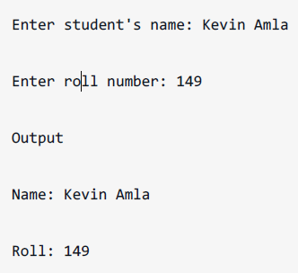
Structure as function arguments Continue…
int main(){
struct student s1;
printf("Enter student's name: ");
scanf("%s",&s1.name);
printf("Enter roll number:");
scanf("%d",&s1.roll);
Display(s1); // passing structure variable s1
as argument
return 0;
}
void Display(struct student stu){
printf("Output\nName: %s",stu.name);
printf("\nRoll: %d",stu.roll);
}
Output
Chapter – 13 : Structures
Chapter – 9 : Looping

Slide 48
Structure as function arguments Continue…
Passing structure by reference (Call By Reference)
The address location of structure variable is passed to function while passing it by reference.
If structure is passed by reference, change made in structure variable in function definition reflects in original structure variable in the calling function.
Example :
#include <stdio.h>
struct distance{
int feet;
float inch;
};
void Add(struct distance d1,struct distance d2, struct distance *d3);
Chapter – 13 : Structures
Chapter – 9 : Looping

Slide 49
Structure as function arguments Continue…
int main(){
struct distance dist1, dist2, dist3;
printf("First distance\n");
printf("Enter feet: ");
scanf("%d",&dist1.feet);
printf("Enter inch: ");
scanf("%f",&dist1.inch);
printf("Second distance\n");
printf("Enter feet: ");
scanf("%d",&dist2.feet);
printf("Enter inch: ");
scanf("%f",&dist2.inch);
Add(dist1, dist2, &dist3);
Chapter – 13 : Structures
Chapter – 9 : Looping

Slide 50
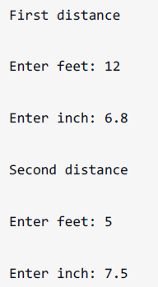

Structure as function arguments Continue…
printf("\nSum of distances = %d\'-%.1f\"",dist3.feet, dist3.inch);
return 0; }
void Add(struct distance d1,struct distance d2, struct distance *d3){
/* Adding distances d1 and d2 and storing it in d3 */
d3->feet=d1.feet+d2.feet;
d3->inch=d1.inch+d2.inch;
if (d3->inch>=12) { /* if inch is greater or equal to 12,
converting it to feet. */
d3->inch-=12;
++d3->feet;
} }
Chapter – 13 : Structures
Chapter – 9 : Looping

Slide 51
Declaration and Initialization of variables Continue…
Note
Passing structure by reference is a lot more efficient than passing structures by value. Passing a structure variable to a function is very similar to passing an array to a function.
Chapter – 13 : Structures
Chapter – 6 : Operators and Expression in ‘C’
Chapter – 9 : Looping

Slide 52
Union
Unions are quite similar to the structures in C. Union is also a derived type as structure.
Union can be defined in same manner as structures just the keyword used in defining union is union where keyword used in defining structure was struct.
Syntax :
union car{
char name[50];
int price;
};
Union variables can be created in similar manner as structure variable.
union car{
char name[50];
int price;
}c1, c2, *c3;
Chapter – 13 : Structures
Chapter – 9 : Looping

Slide 53
Union Continue…
Or Variable can be created inside function
union car{
char name[50];
int price;
};
-------Inside Function-----------
union car c1, c2, *c3;
Chapter – 13 : Structures
Chapter – 9 : Looping

Slide 54
Union Continue…
Accessing members of an union :
The member of unions can be accessed in similar manner as that structure.
Suppose, we you want to access price for union variable c1 in above example, it can be accessed as c1.price.
If you want to access price for union pointer variable c3, it can be accessed as (*c3).price or asc3->price.
Chapter – 13 : Structures
Chapter – 9 : Looping

Slide 55
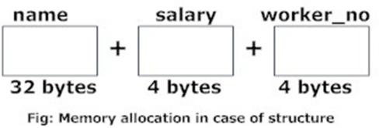
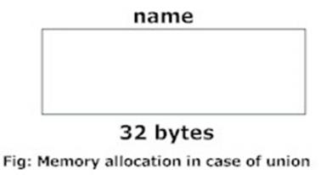
Union Continue…
Difference between union and structure
1. There is difference in memory allocation between union and structure .
The amount of memory required to store a structure variables is the sum of memory size of all members.
But, the memory required to store a union variable is the memory required for largest element of an union.
Chapter – 13 : Structures
Chapter – 9 : Looping

Slide 56
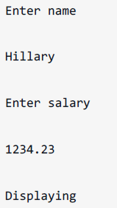
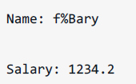
Union Continue…
Difference between union and structure
2. All members of structure can be accessed at any time.
But, only one member of union can be accessed at a time in case of union and other members will contain garbage value.
Example :
#include <stdio.h>
union job {
char name[32];
float salary;
int worker_no;
}u;
int main(){
printf("Enter name:\n");
scanf("%s",&u.name);
printf("Enter salary: \n");
scanf("%f",&u.salary);
printf("Displaying\nName :%s\n",u.name);
printf("Salary: %.1f",u.salary);
return 0;
}
Output
Chapter – 13 : Structures
Chapter – 9 : Looping

Slide 57
Bit Field
In addition to bitwise operators, we can declare structures whose members represent bit-fields
Bit Field Declaration
struct
{
type [m em ber_nam e] : width ;
};
Below the description of variable elements of a bit field:
Elements Description :
type An integer type that determines how the bit-field's value is interpreted. The type may be int, signed int, unsigned int.
member_name The name of the bit-field.
width The number of bits in the bit-field. The width must be less than or equal to the bit width of the specified type.
Chapter – 13 : Structures
Chapter – 9 : Looping

Slide 58
Bit Field Continue…
Example :
struct
{
unsigned int widthValidated : 1;
unsigned int heightValidated : 1;
} status;
The above structure will require 4 bytes of memory space for status variable but only 2 bits will be used to store the values.
If you will use up to 32 variables each one with a width of 1 bit , then also status structure will use 4 bytes, but as soon as you will have 33 variables, then it will allocate next slot of the memory and it will start using 8 bytes.
Chapter – 13 : Structures
Chapter – 9 : Looping

Slide 59
Bit Field Continue…
Example :
#include <stdio.h>
#include <string.h>
/* define simple structure * /
struct
{
unsigned int widthValidated;
unsigned int heightValidated;
} status1;
/* define a structure with bit fields * /
struct
{
unsigned int widthValidated : 1;
unsigned int heightValidated : 1
} status2;
Chapter – 13 : Structures
Chapter – 9 : Looping

Slide 60

Bit Field Continue…
int main( )
{
printf( "Mem ory size occupied by status1 : %d\n", sizeof(status1));
printf( "Mem ory size occupied by status2 : %d\n", sizeof(status2));
return 0;
}
Output
Chapter – 13 : Structures
Chapter – 9 : Looping

Slide 61
Previous Year Question
Fill in the blanks
1. Structure is a ____ data type.
2. Memory is allocated for a structure when ___ is done.
3. A structure member variable is generally accessed using a ___.
4. ____ is a collection of data under one name in which memory is shared among the members.
5. A structure placed within another structure is called a ___.
6. The selection operator is used to _____.

Slide 62
Previous Year Question
Answer the following MCQ :
1. A Data structure that can store related information together is
a. Array b. String
c. Strucure d. All of these
2. A union Member variable is generally accessed using the
a. Address operator b.dot operator
c. Comma operator d.ternary operator
3.Typedef can be used with which of these data types?
a.Struct b.union
c.Enum d.all of these

Slide 63
Previous Year Question
State True or False :
1. A struct type is primitive data type.
2. Memory is allocated for a structure only when we declare variable of the structure.
3.Union and structure are initialized in the same way.
4. A structure cannot have union as its member .
5. C permits nested union.
6.No two members of a union should have the same name .

Slide 64


